Slide 1
KEL’S WORLD
KING KEL

Slide 2
KEL’S WORLD
I am making a visual project all in house (all by myself)
Record mix and master music
Record and edit visuals on Adobe after effects
Complete cover art on photoshop

Slide 3
100% locked in
I want to be great at anything I put my mind to. There’s so many ideas I have to execute, but I don’t want to lose sight of why I started this in the first place. So far my “Big Goal” is to become the best content creator I can be. My future peers will be striving for the same, so I know they will respect it. https://instagram.com/earnest.x?igshid=h0qfue8veygj

Slide 4
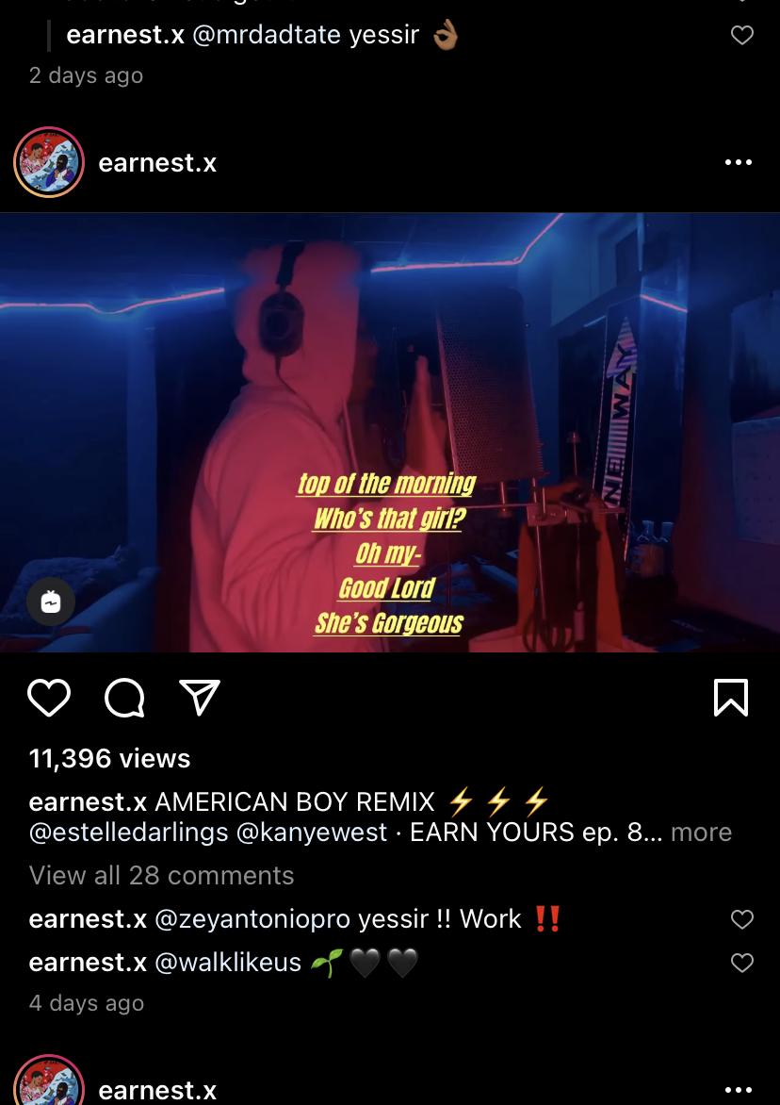
I’m not stealing, just making it better .
All I would take from here is the lyrics added to the videos. That was an idea I had originally but after seeing his, I would like to use some of my typography skills and make it better for my videos
https://www.instagram.com/tv/CIy9JntAdBD/?igshid=jzpvn8vgzcad

Slide 5
Timeline
9/1 Finalize YouTube intro
9/15 Record trial videos
9/30 Determine effects/ make template
10/15 First draft complete
10/30 Second draft complete
11/15 Third draft complete
11/30 Fourth draft complete
12/15 Reworked and completed edits posted

Slide 6
Concerns or motivation?
I need a better system with creating deadlines
Procrastination and no deadlines gets you nowhere
Hopefully I don’t burn out doing everything myself
I have to finish strong by any means

